Slide 1
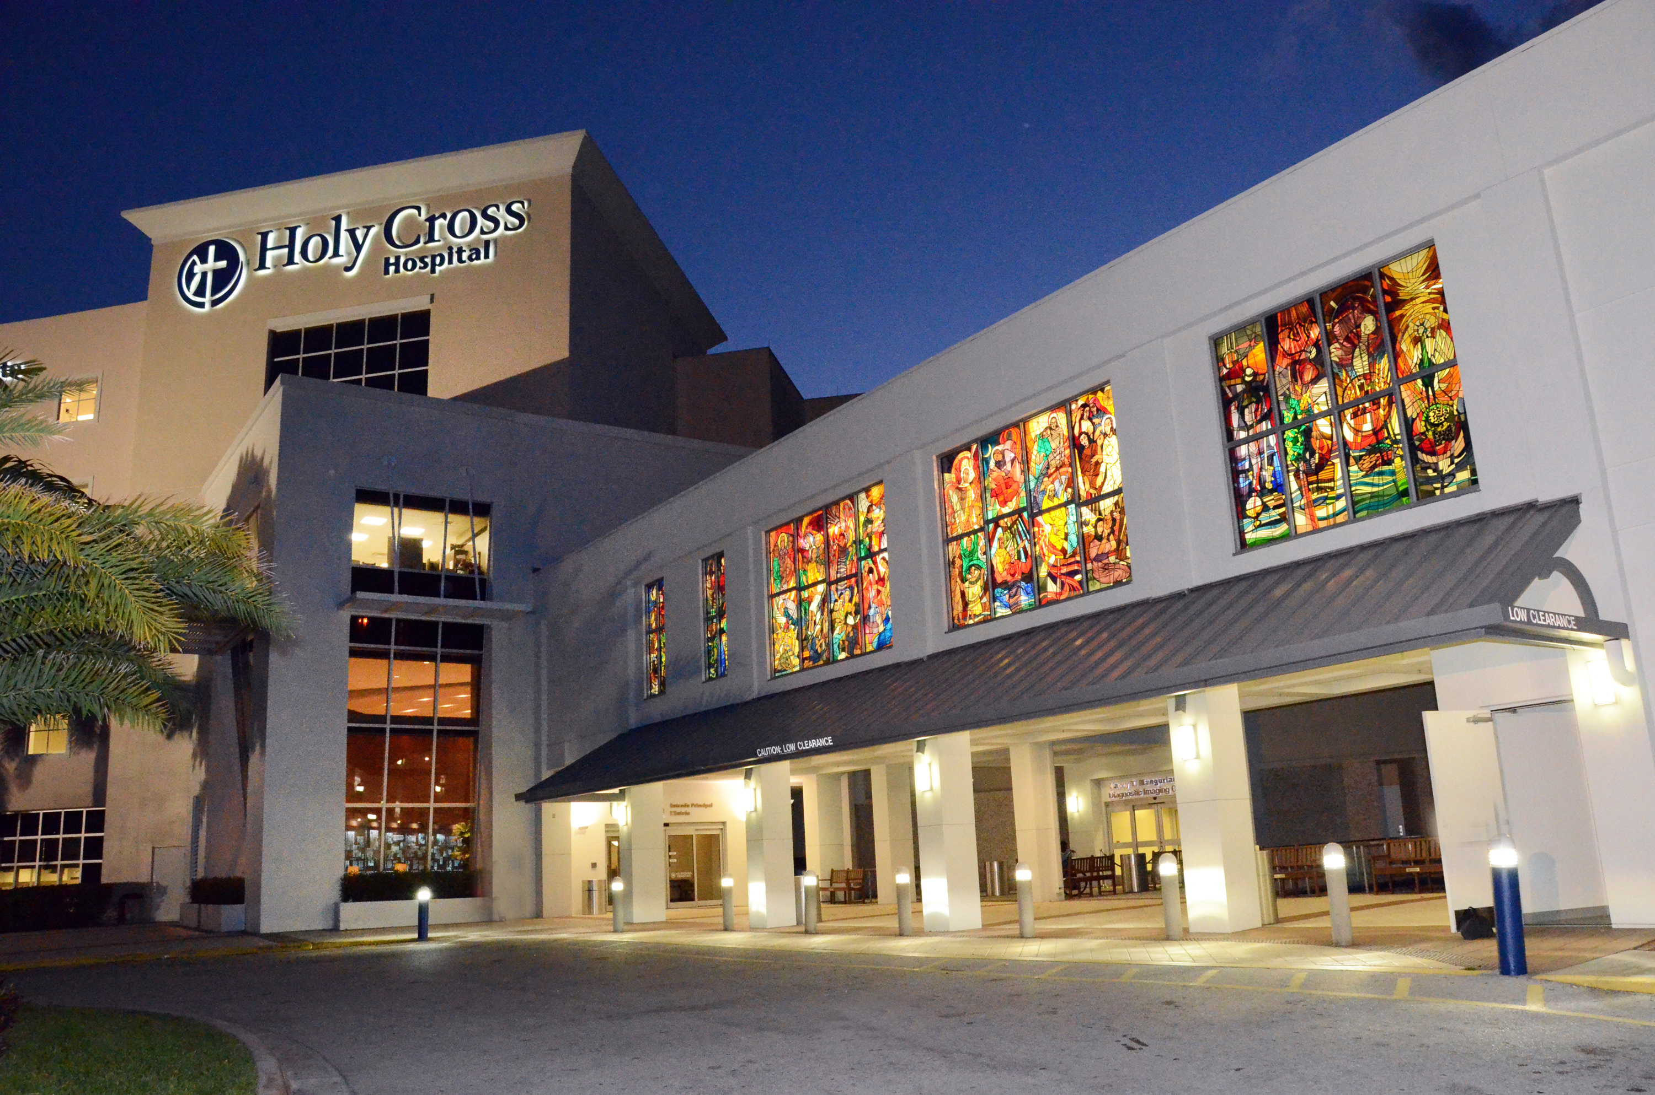
Holy Cross Health
Orientation
Notes:
12/2022 updated; removed electrical safety, hazardous chemicals, fire safety, PPE; already included in system-wide education
2023-This PPT is both student/non-employee version

Slide 2
Topics
About Holy Cross Health
What is Expected of Me
Patient Experience
National Patient Safety Goals
Impaired Healthcare Practitioner
Abuse, Neglect, and Exploitation
Emergency Codes and Workplace Safety
Infection Control
Holy Cross Recognitions

Slide 3
About Holy Cross Health

Slide 4


Holy Cross Mission and Compassionate Service
Private Catholic, non-profit hospital
Diocese of St. Augustine
Sisters of Mercy of Pittsburgh, Pennsylvania
Catholic Health Ministries
Catholic Health East and Trinity Health consolidated to form Trinity Health in 2013
Notes:
Info from Local Ministry Orientation 2021
Reviewed cp 2023

Slide 5



Our Core Values
REVERENCE: We honor the sacredness and dignity of every person
COMMITMENT TO THOSE WHO ARE POOR: We stand with and serve those who are poor, especially the most vulnerable
SAFETY: We embrace a culture that prevents harm and nurtures a healing, safe environment for all
JUSTICE: We foster right relationships to promote the common good, including sustainability of earth
STEWARDSHIP: We honor our heritage and hold ourselves accountable for the human, financial, and natural resources entrusted to our care
INTEGRITY: We are faithful to who we say we are
Our
Mission
We, Trinity Health and Holy Cross Health, serve together in the spirit of the Gospel as a compassionate and transforming healing presence within our communities.

Slide 6
The Why & The How
Vision
As a mission-driven innovative health organization, we will become the national leader in improving the health of our communities and each person we serve. We will be the most trusted health partner for life.
How Will We Know We Have Accomplished Our Vision?
We will know we are people-centered when we put the people we serve at the center of every behavior, action and decision in our ministry. We will know we are successful when we deliver better health, better care and lower costs.
Notes:
Our Strategic Plan Includes Five Focus Areas to Achieve Our Vision
To transform care delivery across the continuum, we will need to find new ways to collaborate and partner with our physicians and clinicians. The care delivery model will require building a team based people-centered approach.

Slide 7

Catholic Sensibilities
Dignity of the Person
The Common Good
Care for the Poor
Solidarity
Stewardship
Subsidiarity
Association and Participation
Caritas/Gratuitousness
Notes:
Reviewed cp 2023

Slide 8
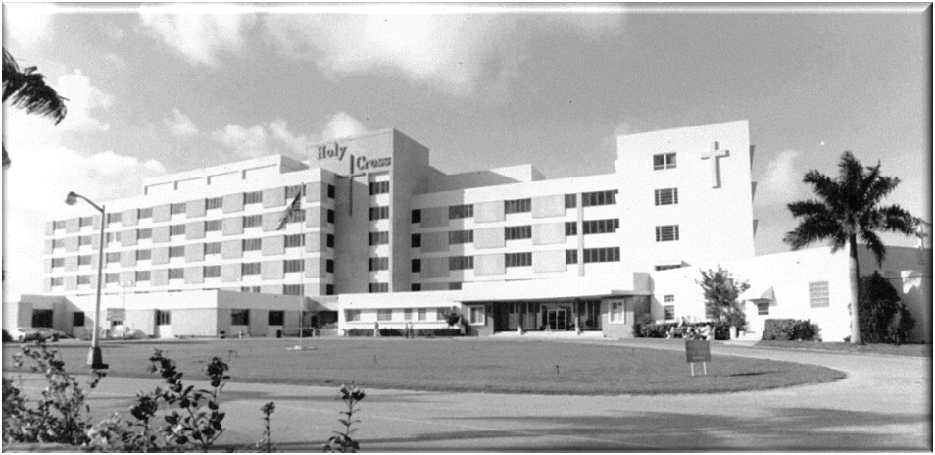
History of Holy Cross Health

Slide 9
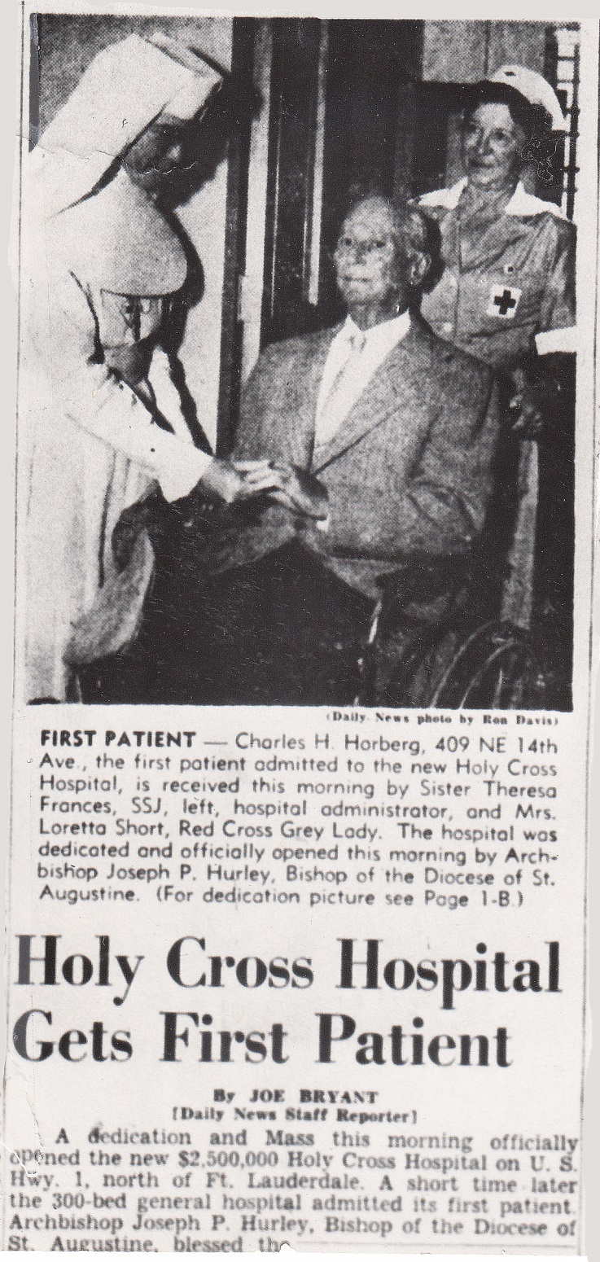
Holy Cross opened its doors on December 8, 1955, with facilities for 100 adult patients.
Notes:
Sister of St. Augustine (4 sisters who were the first Administrator and the first sisters to staff the hospital.) Sisters of Mercy came in 1959.

Slide 10
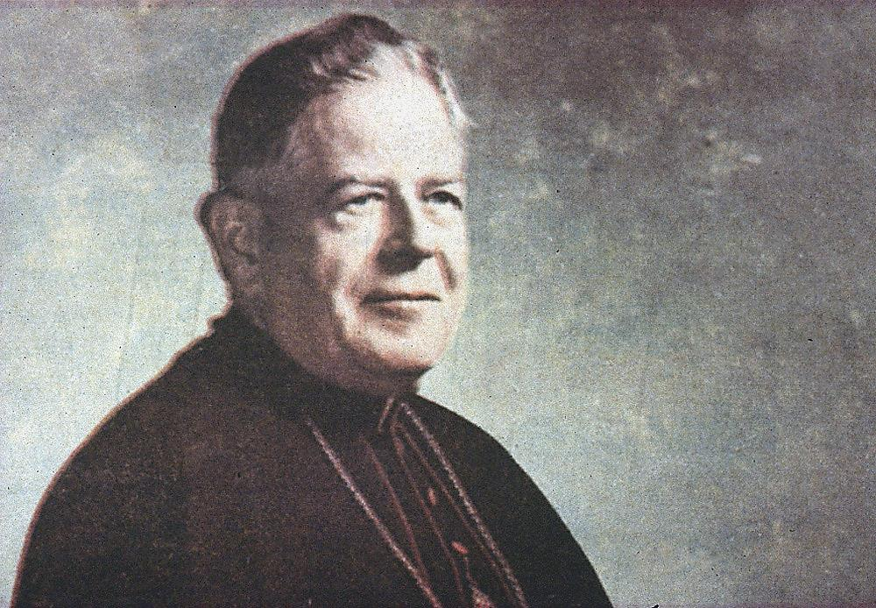
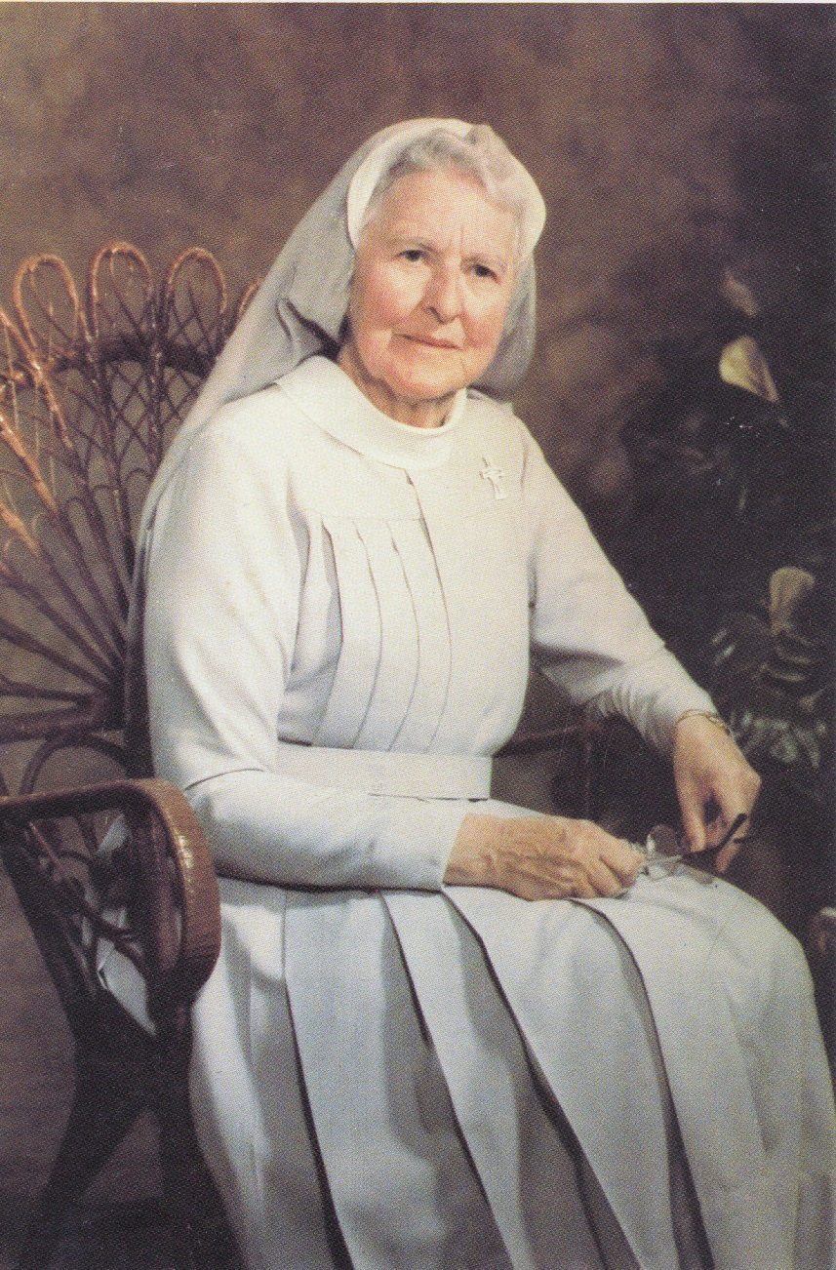
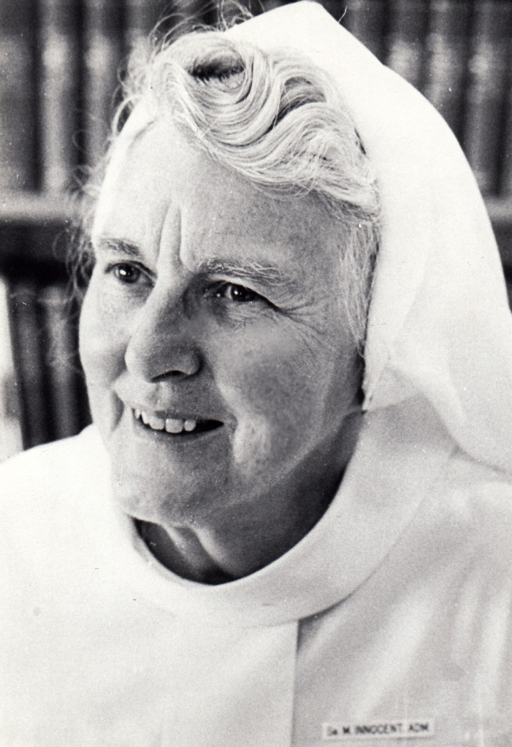
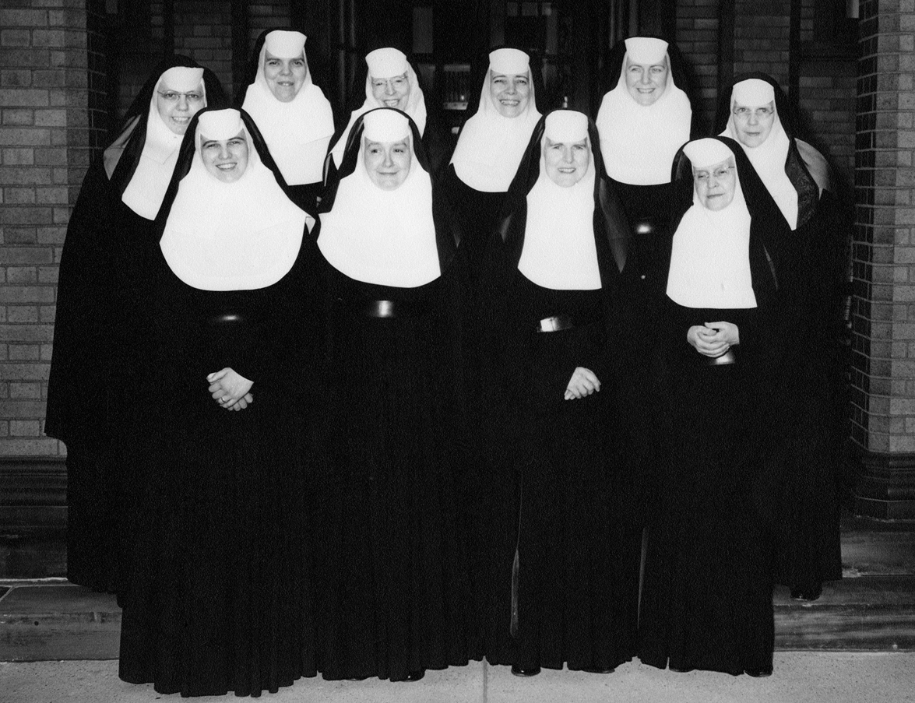
Sister Innocent Hughes
Bishop Coleman F. Carroll
1st Bishop of the Diocese of Miami; 1958
Woman of Vision…Woman of God
First Sister of Mercy Administrator of Holy Cross Hospital
July 1, 1959
Notes:
Sisters of Augustine were at Holy Cross prior to Sister of Mercy (region split diocese). 1st Bishop of the Diocese of Miami from Pittsburgh; he invited them down to help serve.. 10 Sisters of Mercy arrived from Pittsburgh who arrived in 1959 to serve the needs of the people. Sr. Innocent was the first Sister of Mercy Administrator of Holy Cross Hospital.

Slide 11


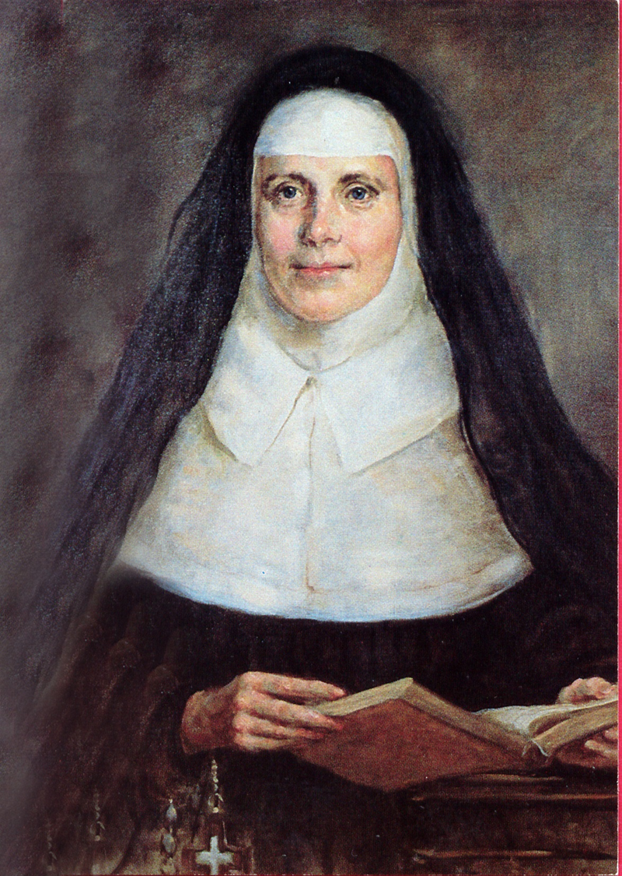
History of Sisters of Mercy
Sisters of Mercy were founded in Dublin, Ireland by Catherine McAuley on December 12, 1831.
Sisters of Mercy came to the United States in 1843.
Sr. Francis Ward
Mercy Hospital, Pittsburgh, Pennsylvania, est 1847.
Catherine McAuley
Notes:
We consider her to be the American Foundress of Sister of Mercy. She and six other sisters arrived on December 21, 1843 to care for the needs of the people of Pittsburgh, Pennsylvania. (
This was the first Sisters of Mercy Hospital built in the United States.

Slide 12
What is Expected of Me

Slide 13
Standards of Conduct
Colleagues and non-employees are expected to conduct themselves and behave in a manner that is consistent with the Code of Conduct, exemplifies our organization’s Core Values and Service Excellence and is conducive to a customer friendly and efficient operation of Holy Cross Health.
Notes:
Reviewed cp 2023

Slide 14

Sexual Harassment
Against policy and the law!
Unwelcome sexual advances, requests for sexual favors, or other conduct of a sexual nature that explicitly or implicitly affects an individual's employment or unreasonably interferes with an individual’s work performance or creates an intimidating, hostile or offensive work environment.
        Verbal/nonverbal
        Physical
        Visual/Environmental
Includes behavior in which people are treated differently on the basis of their gender.

Slide 15

Workplace Violence Policy
Colleague safety is as important as patient safety and HCH has zero tolerance for workplace violence committed by or against Colleagues
Prohibited conduct includes:
    Causing physical injury to another person
    Making threatening remarks
    Aggressive or hostile behavior that creates a reasonable fear of injury or causes emotional distress
    Intentionally damaging property of Employer or another Colleague
Notes:
Policy added to resource 10.28.23

Slide 16

Colleague Conduct Policy
Conduct that can lead to immediate termination:
    Reporting to work under the influence
    Possession of firearms or other weapons on hospital premises
    Disruptive behavior
    Insubordination
    Engaging in any form of harassment
    Theft, destruction of hospital property
    Sleeping on the job
    HIPAA Violations
    Workplace Violence
Notes:
8.29.23 Removed policy number unable to locate that way

Slide 17
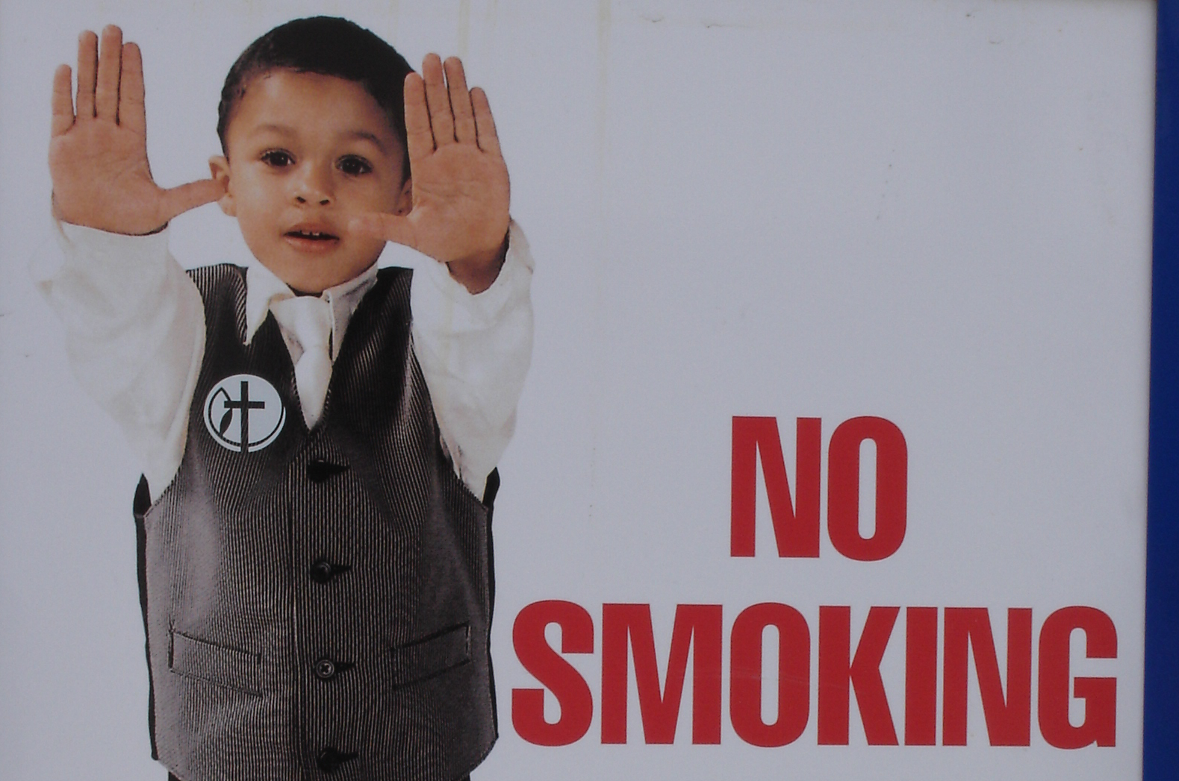
Drug-free and Smoke-Free Environment
Holy Cross is committed to maintaining a safe and drug-free work environment for colleagues, patients and visitors.
Smoking or use of tobacco products is prohibited at Holy Cross Health, Healthplex, and Wells Fargo campuses (includes parking lots). Smoking includes vaping or use of e-cigarettes.
Smoking is permitted for patients and visitors only in designated areas outside of the hospital or any other facility.

Slide 18
ID Badge
Your ID badge must be worn at all times while you are on duty. Your badge is a critical component of workplace safety and customer service.
ID badge functions include:
Facility access – external & internal
Parking lot access

Slide 19
Safety & Security Updates
Continue to assess and restrict access to entrances at all HCH facilities to help create safer and more secure environment.
All employees and non-employees are to part in designated parking areas- parking garage and the parking lots along Commercial Blvd; students(i.e. 5th-6th-7th floors). Violators will have their vehicles towed at their expense.
Notes:
8.29.23PolicyStat ID10116253

Slide 20

Masking
Holy Cross Health will comply with required Universal Masking and PPE protocols as outlined in the attached reference material:
Universal Masking Practice:Coronavirus 2019(COVID-19)
COVID-19 PPE Guide Booklet (Use Qr Code to access Web-based Resource)
Notes:
Added 2023

Slide 21
Patient Rights & Responsibilities
Upon admission, all patients are given a copy of their Rights & Responsibilities.
  Examples:
  Right to Informed Consent
  Right to Good Quality Care & High Standard
Patient Rights – What do you need to know?
  All staff need to know we provide the Notice of Patient Rights
  Registration staff provides the Notice of Rights at the start of patient care or upon admission
  Location of Notices
    Displayed in all outpatient/inpatient locations, Urgent Care Centers and Physician practices
    Brochures in waiting areas and at registration desks

Slide 22
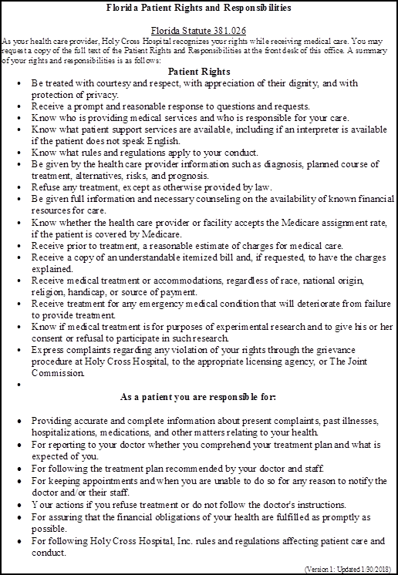
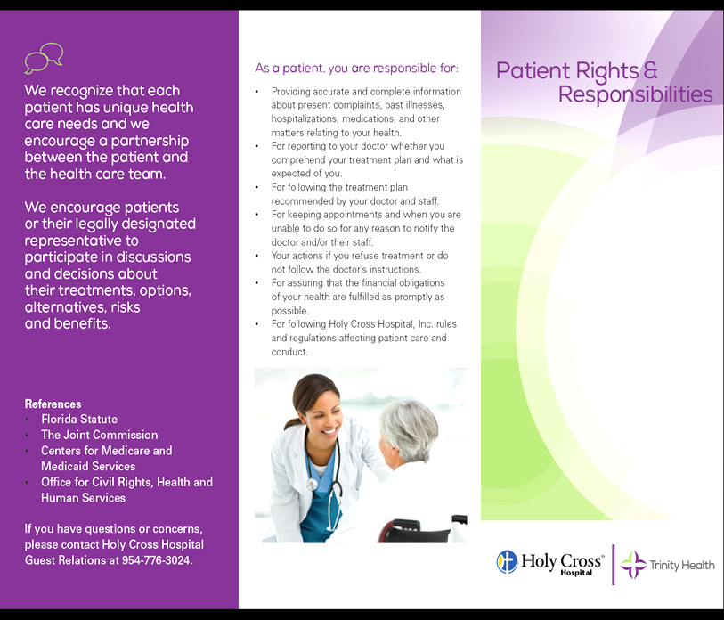
Patient Rights – Notice & Brochure

Slide 23
Patient Experience

Slide 24
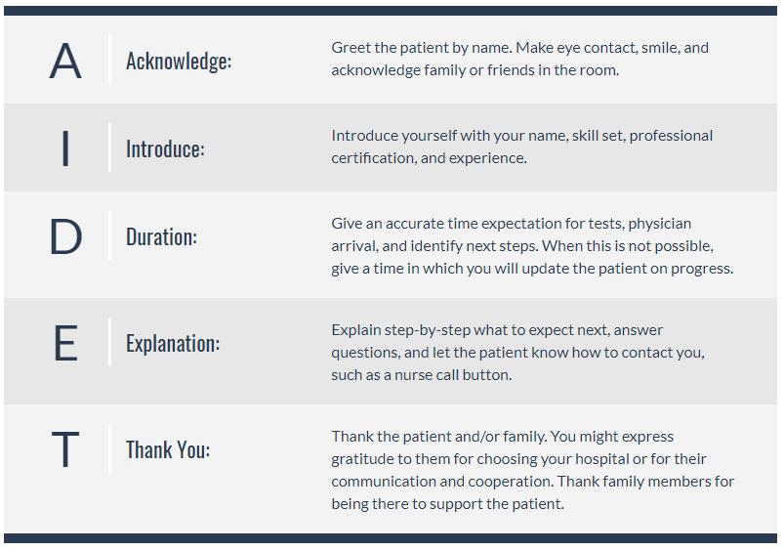
AIDET: a way to communicate in healthcare

Slide 25
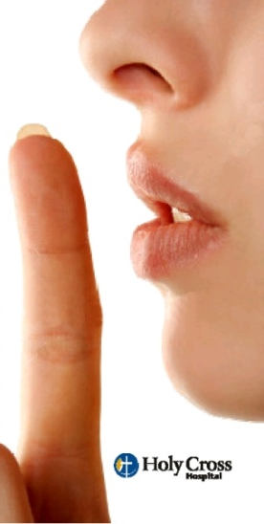

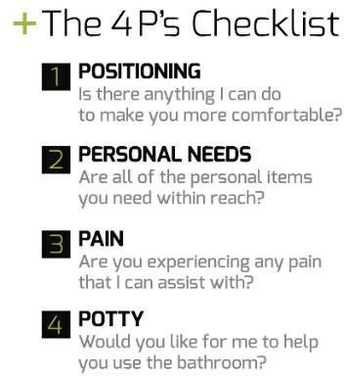

Shhh…Silence Helps Healing Happen
Our patients need a quiet environment to aid in their healing and recovery.
Please…
Be mindful of your voice volume when speaking to others.
Close their door when appropriate.
Report equipment that makes excessive noise.
Be particularly aware of the noise level around staff areas (i.e. nurse’s station).
Notes:
3/2019-added 5th P-Preference

Slide 26
HCH Action to Preventing Patient Falls
ACTIONS - all patients are at risk for falls
Bed alarm/chair alarm (low bed HAS a built-in alarm)
Stay with me initiative (remaining within 3 feet of fall risk patient during toileting)
Call light within reach
Frequent toileting
Remote sitter monitoring via AvaSure system
Low bed and mat
Patient lift equipment
Gait belt
  Risk for Falls magnet on door
  Yellow bracelet
  Yellow non-skid socks
  Hourly rounding
  Education to patient and family
  Document falls risk on “ticket to ride”
  Shift report-fall risk
  Care plan to note fall risk
  Remove clutter

Slide 27
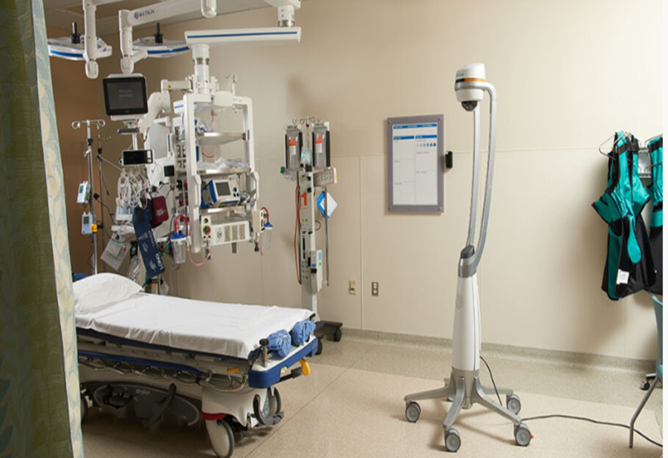
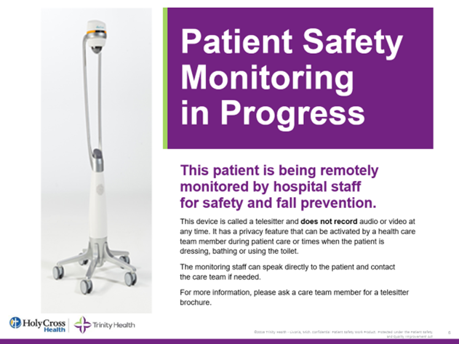
AvaSure Virtual Patient Monitoring
Holy Cross Health has implemented the AvaSure Virtual Monitoring Program to help monitor and promote safety for the at-risk patient remotely. The mobile Telesitter unit is equipped with one-way video and two-way audio communication allowing the virtual monitoring attendant to respond in situations where a verbal reminder is needed to redirect the patient.
Physician order is not required
The device does not record
Additional consent is not required
A privacy mode is available
When the yellow light is on, monitoring staff can see into the room
When the yellow light is off staff cannot see into room and privacy mode is activated

Slide 28



Location of Handicap Facilities
Provide assistance to individuals with disabilities.
If you are not able to provide assistance, please get someone who can.
Handicap Accessible Drinking Fountain | Sample Location: Main Lobby Emergency Room
Handicap Bathroom | Sample Location: Main Lobby By Visitor Elevator
A TDD device to assist the hearing impaired with making phone calls | Sample Location: Emergency Room PBX office has one for patient use
Notes:
10.28.23 reviewed

Slide 29

Visitor Policy
Holy Cross will not restrict, limit, or deny visitation privileges on the basis of the following: Race, Color, National Origin, Religion, Sex, Sexual Orientation, or Disability.
General Guidelines (see Policy on Visitors to Hospital to see complete list)
To optimize patient’s ability to rest, the hospital recommends visiting between 11:00am – 8:00pm
Patient care is our first priority. In the best interest of patient care, the physician, licensed independent provider or the nursing supervisor or nurse manager may, at any time, restrict visitors to a patient or restrict the number of visitors.
NOTE: See Visitor Policy on visitor restriction regarding Covid-19 (access PolicyStat)
Recognizing that patient support from a family member or friend contributes to patient experience, safety and healing, we desire to balance these important elements with the need to protect patients and Colleagues from unnecessary exposure to COVID-19.
Notes:
10.28.23 Reviewed includes

Slide 30

Where to find Holy Cross Policies
From the ZenWorks window, click the PolicyStat
On the Search bar, enter a keyword to search a policy. For example:
Notes:
5/2022-updated screenshots

Slide 31
Interpreter Services
Language Line Solutions
MARTTI
Certified Languages
Questions
onsiterequests@fluentls.com
1-800-225-5254 Passcode: Holy CH
App on iPad
Guest Relations
954.542.3024
Language Line Solutions is to request onsite American Sign Language Interpreter. You must contact email above to request 10 days in advance by filing out form (Can request from Guest Relations)
MARTTI, our preferred method, is a virtual app on our iPad used for all languages including ASL. MARTTI is located at each nurse's station, ER, HealthPlex, and most outpatient locations
Certified Languages is a telephone line to call for certified language interpretation, not including ASL
If you have any questions regarding these services, please do not hesitate to reach out to Guest Relations
Notes:
12.1.2023 Shawnie Turner-Rigg <Shawnie.Turner-Rigg@holy-cross.com>

Slide 32

MARTTI
Use the link below to access Martti on the web through any web browser that has a speaker and camera.
Any user ID can be used, ID is located on the iPad.
Please utilize Certified Languages as well.
http://cloudbreak-customer-ui.prod.cloudbreak.us/
Notes:
12.1.2023 Martti being updated

Slide 33
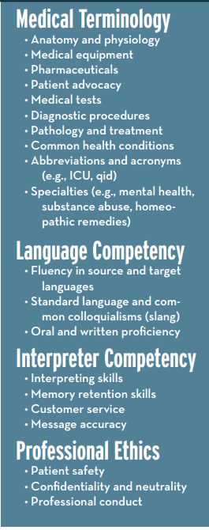

Language Services
Certified Languages International (CLI)
1-800-225-5254 (2255CLI)
  200+ languages
  Available 24/7/365
  TDD located in Nursing Hub and in the Emergency Department.

Slide 34
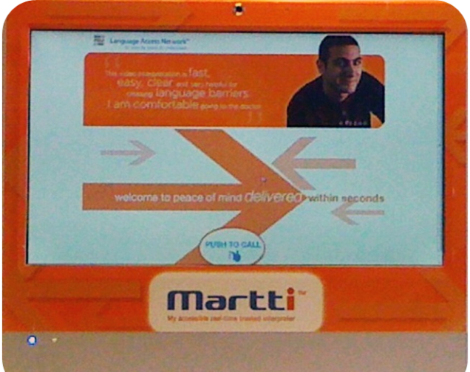
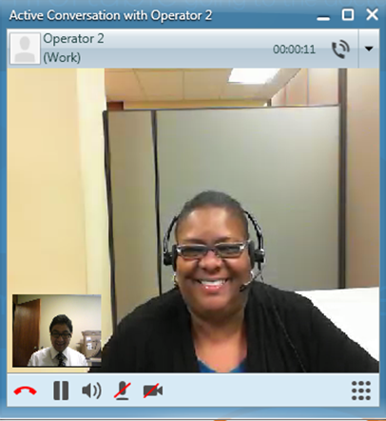
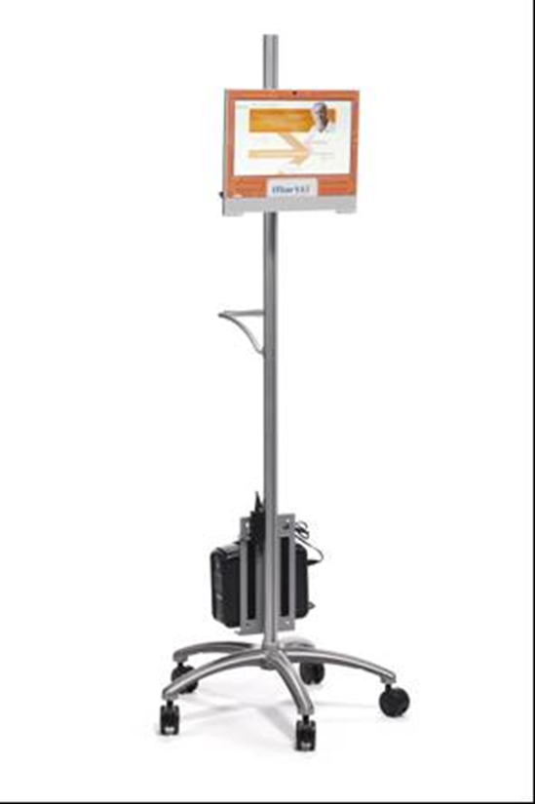
MARTTI - Our Video Interpreter
Qualified Trained and Tested
24/7 365 Access
  Offers 210+ languages including American Sign Language
  Medical Interpreter training
  Independent language assessments
  Continuing education
  Members of NCIHC (National Council of Interpreting in Heath Care)
  Follow National code of Ethics and Standards
  HIPAA and Confidentiality agreements
Notes:
.

Slide 35
Using Interpreters
When discussing medical information especially Advance Directives, Treatment Options, Informed Consent and Discharge Instructions use the patient’s preferred language with a qualified interpreter
Document in the Medical Record the method of translation
A family member or friend should not be used as an interpreter. Use of such persons could result in a breach of confidentiality or reluctance on the part of the patient to reveal personal information critical to their situation

Slide 36
Cultural Competency
In the healthcare setting, cultural competence refers to the
ability to provide optimal care to members of various cultural groups defined by common traits such as age, race, gender, sexual orientation, to name a few.
  This ability rests on a set of:
    Attitudes
    Skills
    Policies
    Practices
This set of qualities makes it easier for providers to:
    Understand their patients
    Communicate with their patients
The end result is optimal care for all patients.
Notes:
Diversity & Inclusion in NNCO topic

Slide 37
Culturally Competent Provider
Providers must understand the patient’s:
  Values
  Health-related beliefs and practices
  Views about his or her current illness
  Nutrition
  Socioeconomic status
  Communication patterns
  Cultural affiliations
  Educational background
Providers must be able to provide healthcare to:
  Patients who do not speak English
  Patients from different cultures
Notes:
5/29-2020 updated bullet points

Slide 38
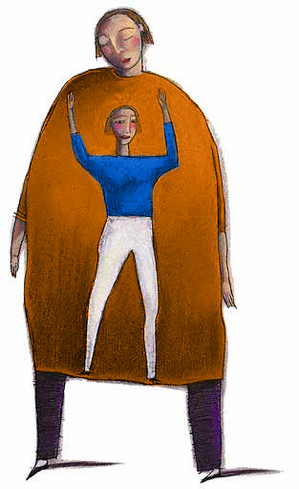
Bariatric Sensitivity
The term bariatric refers to patients whose weight exceeds the safety capacity of standard patient lifting equipment (approximately 300 lbs.) or who otherwise have health issues, limited mobility, and limited environmental access due to their weight and size (Galinsky 2010).
Bias against individuals who are obese remains a widespread phenomenon.
Overweight and obese patients are faced with issues that goes beyond their physical condition
Bariatric patients have the right
  to be treated as unique individuals
  to receive sensitive and dignified care
Notes:
5/29/2020 updated

Slide 39
National Patient Safety Goals

Slide 40
Reporting Safety/Quality of Care Concerns
The Joint Commission (TJC) represents a commitment to Patient Safety and Quality of Care.
Any Holy Cross staff, physician, student or volunteer who has concerns about the safety or quality of care provided in the hospital may report these concerns to The Joint Commission or to the Agency for Health Care Administration (AHCA).
No retaliatory or disciplinary action will be taken against individuals who report safety concerns to The Joint Commission or AHCA.

Slide 41
Contacting TJC and AHCA
The Joint Commission
Agency for Health Care Administration
FAX: 1-630-792-5636
Email: complaint@jointcommission.org
Address:
Office of Quality Monitoring
The Joint Commission
One Renaissance Boulevard
Oakbrook Terrace, IL 60181
Toll-Free : 1-888-419-3456
Address:
Agency for Health Care Administration
2727 Mahan Drive
Tallahassee, Florida 32308

Slide 42


2024 National Patient Safety Goals
Click Resources for 2024 NPSG Summary
The purpose of the National Patient Safety Goals (NPSG) is to improve patient safety. The goals focus on problems in health care safety and how to solve them.
Safety is a Holy Cross Core Value
Notes:
10.28.23 Upload the 2024 National safety Goals summary

Slide 43


Goal: Identify patients correctly
Always use 2 patient identifiers (name & date of birth)
Ask the patient to verbally state their name and birth date when possible
Identify patient when:
  Administering medication or blood products
  Collecting blood samples or specimens
  Providing care, treatment, or services

Slide 44
Goal: Improve staff communication
Important Communication Tools for Patient Safety:
1) Handoff – Clearly communicating vital information between different care providers. Example: During shift change, when transferring a patient. Provides an opportunity to ask questions, clarify, and confirm
2) Check Back – Using closed loop communication to make sure the correct information is received. Example:
Nurse: “Mr. Smith needs to go to Room 256-1”
Transporter: “Mr. Smith to Room 256-1”
Nurse: “That is correct. Thank you”

Slide 45
Goal: Use medicines safely
Use medicines safely
Before a procedure, label medicines that are not labeled
Take extra care with patients who take medicines to thin their blood
Record and pass along correct information about a patient’s medicines

Slide 46
Goal: Use alarms safely
Alarms must be recognized, interpreted, and acted on by a knowledgeable person in a timely fashion
Alarms must be immediately reviewed and validated by patient assessment
Ensure proper lead placement, signal quality, and setting of alarm parameters
Know the default alarm settings of monitors
Set "reasonable" alarm settings

Slide 47
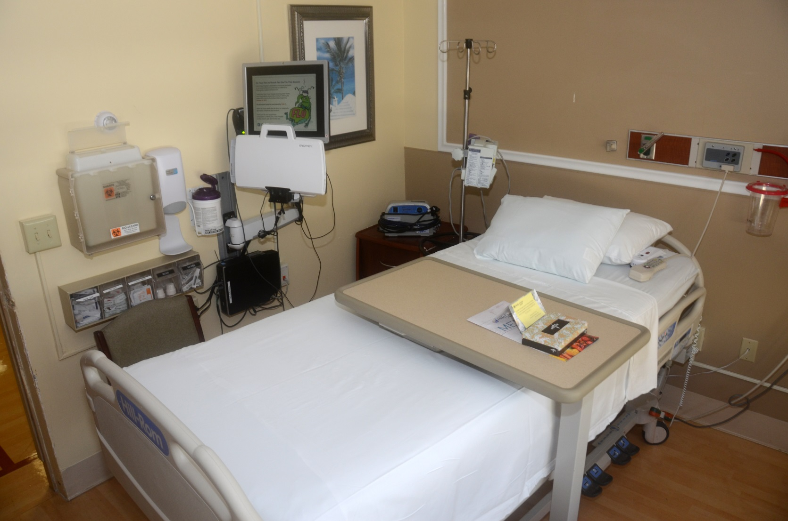
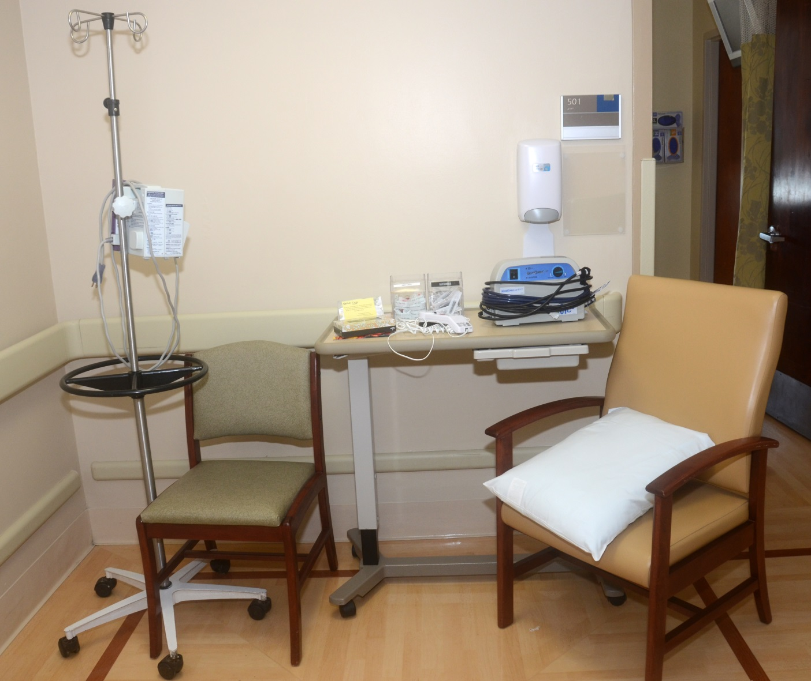
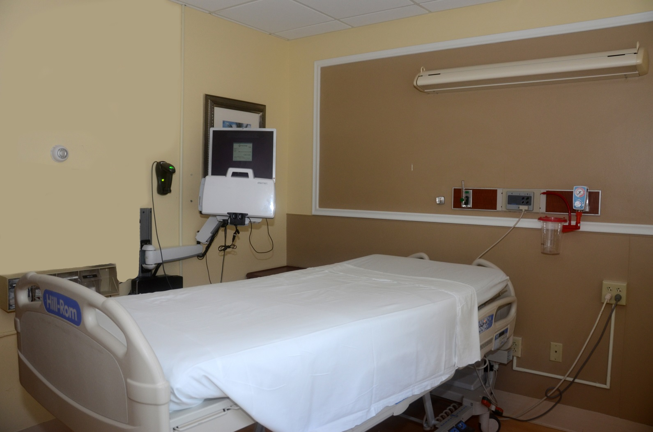
Goal: Identify patient safety risks
Prevent a suicide-Intervene-take any threat of Suicide seriously
Reduce Hanging Risk in the Physical Environment
Suffocation or strangulation (hanging) by bell cord, bandages, sheets, a restraint belt, plastic bags, elastic tubing, or oxygen tubing is a common method of suicide while in a health care facility. (Lippincott)
Normal Patient Room
Items Removed
Baker Act Patient Room

Slide 48
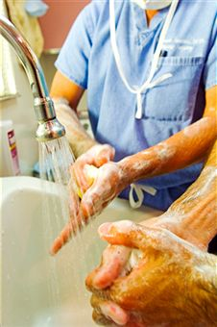
Goal: Prevent infection
Hand Hygiene
  The single most important method of preventing infections
  Soap & water must be used when caring for patients with Clostridium difficile (C. diff).
We are ALL hand hygiene coaches!
"May I remind you to wash your hands?"

Slide 49

Goal: Prevent mistakes in surgery
Follow the Universal Protocol to Prevent Wrong Site, Wrong Procedure, and Wrong Person Surgery
The patient is involved, when possible, in identification, site marking
Site marking - use consistent format
A Time Out is performed before the procedure
Your job is to STOP the LINE if needed!

Slide 50
Impaired Healthcare Practitioner

Slide 51

Impaired Healthcare Practitioner
Impairment is defined as the condition of being unable to perform one’s professional duties and responsibilities in a reasonable manner and consistent with professional standards.
Impairment may be as a result from dependence or misuse or abuse of alcohol or drugs, or both, or due to a mental or physical condition which could affect the licensee’s ability to practice with skill and safety.
Notes:
http://flboardofmedicine.gov/general-faqs/
http://www.flprn.org/faqs

Slide 52

Warning Signs of Practitioner Impairment
Warning signs of impairment may include
Personality changes or mood swings that occur rapidly or over time, such as increased irritability, hostile or unreasonable behavior, erratic outbursts
Deterioration of personal hygiene and clothing habits
Memory lapses or generalized forgetfulness
Withdrawal from social situations
Change in clinical judgment or behavior such as undue delay in returning consultation calls
Inappropriate orders or over prescribing medications
Complaints from hospital personnel, patients/family
Makes frequent medication errors
Notes:
http://www.flprn.org/faqs

Slide 53
Florida DOH Impaired Practitioner Program
Florida health care professionals can seek assistance for impairment through the Department of Health's Impaired Practitioner Program
Intervention Project for Nurses (IPN)
- Established in 1983 through state legislation to ensure public health and safety through a program that provides close monitoring of nurses who are unsafe to practice due to use of drugs (including alcohol) or psychologic/psychiatric or physical condition.
Professional Resource Network (PRN)
  - A nonprofit organization that provides referral services for evaluation and treatment of impaired practitioners.
- The Florida Medical Practice Act permits the confidential treatment of physicians with impairments.
Notes:
4/14/2020 www.flhealthsource.gov/board-members-impairment-programs.

Slide 54
Abuse, Neglect, and Exploitation
Notes:
Updated from policy-revised 3/17/2014; next policy review 12/11/2021

Slide 55
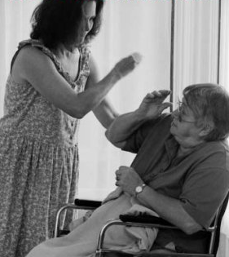
Signs and Symptoms of Abuse
Abuse - (child, domestic partner, elderly or disabled adult) the non-accidental infliction of pain and injury.
Signs of Physical Abuse or Physical Assault - intentional infliction of pain or physical injury or use of force
  Bruising
  Lacerations
  Fractures
  Various stages of healing of any bruises or fractures
  Burns
  Multiple & recurrent injuries
  Injury histories inconsistent with physical findings
Signs of Emotional or Psychological Abuse
  Ambivalence, deference, passivity, shame
  Anxiety (mild to severe)
  Depression, hopelessness, helplessness, thoughts of suicide
  Confusion, disorientation

Slide 56

Signs and Symptoms of Abuse
Signs of Sexual Abuse - includes rape or sexual assault/molestation
  Trauma to the genital and/or anal area such as bruises, bleeding, lacerations
  Sexually transmitted disease
  Infections/unusual discharge or odor
Signs of Financial Abuse
  Cashing checks without authorization or permission
  Forging an older person’s signature
  Misusing or stealing an older person’s money or possessions
  Forcing or deceiving an older person into signing a document (e.g., contracts or a will)

Slide 57
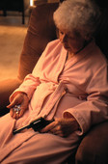
Neglect and Exploitation
Neglect - (child, elderly, disabled adult)
  The failure or omission to provide the care, supervision and necessary services to maintain physical and mental health.
  Example: deprivation of adequate food, hydration, clothing, shelter, medicine or medical care.
Exploitation - (elderly or disabled adult)
  When a relative or care giver knowingly, by deception or intimidation, obtains and misuses the funds, assets or property of an adult with disabilities or a person 60 years or older for personal or monetary gain.
  Example: taking Social Security or SSI checks, abusing checking accounts and taking property and other resources without consent.

Slide 58
Screening and Assessment
Identification of possible victims of abuse, neglect, and exploitation occurs through inquiry and/or observation of clinical presentation using the screening assessment tools in the electronic medical record or manual patient record as appropriate.
Colleagues identifying individuals that have met criteria of suspected abuse, neglect, or exploitation should initiate the hospital referral process.
Refer to Policy Abuse, Neglect, Exploitation: Recognition and Reporting (Appendix A)
Notes:
As of 10/28/2023, based on policy last reviewed Reviewed
7/10/2023

Slide 59
Referral and Reporting
  Adult patients who are suspected of having been abused, neglected or exploited are identified and assessed. Referral for appropriate resources and treatment are offered. Refer to Appendix B for Private and Public Community Agencies Referral List (refer to Policy-Abuse, Neglect, and Exploitation)
  For a child or vulnerable adult who is suspected of having been abused, neglected or exploited, mandatory reporting (Florida Statute) is required and the Associate will notify the following:
    Immediate Supervisor/Coordinator/Manager
    Physician
    Risk Manager
    Florida Abuse Hotline at 1-800-96ABUSE (800-962-2873)
Notes:
Policy last reviewed 12/12/2018

Slide 60
Emergency Codes
Workplace Safety

Slide 61
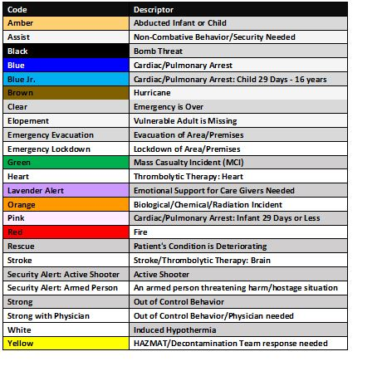
Emergency Codes
Notes:
Updated 10/2023

Slide 62
Disaster Preparedness
Emergency Operations Plan (EOP)
Describes the hospital's emergency preparedness program and ensure an effective response to a variety of natural or man-made disasters that could cause harm and/or disrupt the environment of care.
The plan provides distinct policy direction, describes the roles and responsibilities of Colleagues and contains information and references to corresponding departmental mitigation, preparedness, response, and recovery procedures.
Notes:
EOP policy last reviewed 12/16/2021

Slide 63
EOP Scope
The plan identifies the alert, notification, and activation of key Colleagues, the internal management structure and reporting relationships, as well as coordination with external agencies and the community. The plan and corresponding procedures address four phases of emergency management: mitigation, preparedness, response, and recovery and the six critical areas:
Communication
Resources and Assets
Safety and Security
Staff Responsibility
Utilities Management
Patient Clinical and Support Activities
Notes:
Added from EOP policy

Slide 64
Coordination with Community
Holy Cross Hospital, Inc.’s Role in Emergency Management Program: Holy Cross Hospital, Inc. participates in several communitywide emergency management programs, such as the Broward County Healthcare Coalition. Holy Cross Hospital Inc.’s role in relation to these entities in the event of a disaster is discussed, planned, and drilled for accordingly.

Slide 65



Environment of Care: Medical Equipment Safety
How do you know equipment is safe to use?
“Spot the Dot” system: Dot indicates the month/year of the next scheduled medical equipment annual preventative maintenance (PM)
  2023: Light Blue
  2024: Light Grey
  2025: Green
Black label indicates equipment does not require annual PM
Some equipment may have 2025 stickers due to a
2-year battery replacement or schedule maintenance every 2 years
12
1
6
Notes:
Asking for a NAME OF SOMEONE TO REVIEW
12.3.2023 asked Carol
12.4.23 Carol verified with Chris Parsons and revised

Slide 66

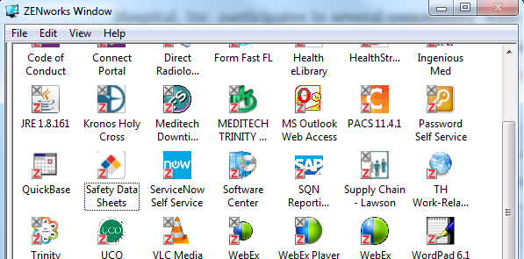
What is “SDS” and where can you find it?
SDS = Safety Data Sheet
  Information sheet from the manufacturer on chemicals
  Contains instructions on safe use & response actions in case of harmful exposures
Located on desktop
(ZENworks window)
or
Reached by Hotline
(1-888-362-7416)
Notes:
3/2019-Updated SDS graphic

Slide 67
What to do if a possible Chemical exposure occurred!
Notify immediate supervisor, and if you are not protected, remove yourself from exposure area and utilize appropriate PPE.
If you know how to handle the spill, (use SDS and department protocol) contain the hazard or secure area until further directions have been given.
Call Safety and Security (Ext. 3099) for assistance to contain the spill if needed.
Any exposure that makes you to have symptoms such as respiratory difficulty, burning to skin or eyes, redness or swelling-report immediately to Emergency Department.
Complete an incident report and report to Occupational Health for follow-up.
Colleague Health Office at the Hospital or Occupational Medicine Office at the HealthPlex Medical Plaza are also excellent resources for any questions - 954-492-5776 or 954-229-8666.
Notes:
2022-reviewed slide

Slide 68
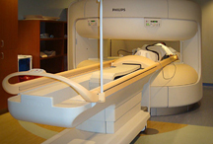
MRI Safety
The MRI technologist will be responsible to control access to the MRI imaging suite at all times and will ensure that the following safety precautions are followed:
  NO metallic (ferro-magnetic) objects will be allowed entry in the MRI imaging suite such as equipment, O2 tanks, stretchers, wheelchairs, etc.
    All metal objects must be scrutinized.
  2. ONLY patients and individuals that have been properly screened and cleared for contraindications within a magnetic field will be allowed entry into the MRI imaging suite.
Notes:
Reviewed/approved by Joe Demartino 2022

Slide 69







MRI Safety
Examples of items NOT allowed in the MRI suite: (these are not the only items that cannot go into the MRI suite)
HCH ID badge/film badge
Credit cards/bank cards
Watch
Coins
Keys
Hearing aids
Magnetic false eyelashes
Jewelry, pins, body-piercing items
Metal eyeglasses
Metal pens
Belts
Stethoscopes
Hemostats
Scissors
Notes:
Added magnetic false eyelashes

Slide 70
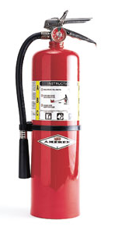
MRI Safety
CODE RED (Fire): In case of a Code Red in the MRI room
Immediately remove the patient from the room.
Use only MRI safe/approved Fire Extinguisher located by the MRI suite.
CODE BLUE: In case of a Code Blue in the MRI room:
Immediately remove the patient from the scanner, placing them on the non-magnetic stretcher kept permanently in the area.
Code Blue team administers emergency care to the patient OUTSIDE the MRI room
Emergency equipment or Oxygen tanks are NOT ALLOWED

Slide 71
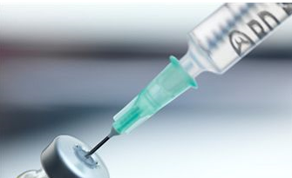

Sharps Injury Prevention
Click Resources to read Sharps Safety
The CDC estimates that each year 385,000 needlesticks and other sharps-related injuries are sustained by hospital-based healthcare personnel; an average of 1,000 sharps injuries per day .
Use caution when handling, administering and/or disposing of any sharps.
Review CDC recommendations on Sharps Safety for Healthcare Professionals
Notes:
3/2019-link to Sharps Safety file

Slide 72

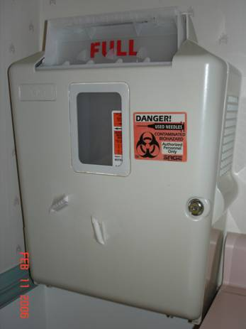

Sharps Containers
Notes:
5/2022-updated from Lifeguard
Sharp Safety pdf upload

Slide 73


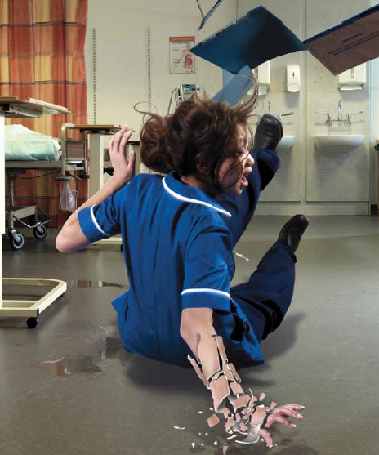

Slips, Trips, & Falls
Exposure to wet floors or spills and clutter can lead to Slips, Trips, and Falls causing potential harm to self/patient or a family member.
Recommended Good Work Practices:
Keep floors clean and dry.
Provide warning signs for wet floor areas.
Keep aisles and passageways clear and in good repair with no obstructions.
Access to exits must remain clear of obstructions at all times.
Provide adequate lighting especially during night hours.
Do not use stools, chairs, or boxes as substitutes for ladders.
Utilize HCH S.T.O.P.P. Safety Program initiative to prevent colleague/patient injuries.
Workplace accidents are preventable when we remember to Stop, Think, Observe, Prepare and Proceed.
Notes:
Reviewed by Adorno 3/25/2019

Slide 74

Trinity Health Employee Incident Reporting (THEIR)
All colleague injuries are to be reported to the T.H.E.I.R. system.
Complete on-line THEIR report within 24 hours
To find the form:
From the ZENworks window, click on the TH Work-Related Incident
Reporting icon.
Notes:
Updated icon 5/2022

Slide 75

Infection Control
Notes:
Reviewed by Sue for FY20

Slide 76
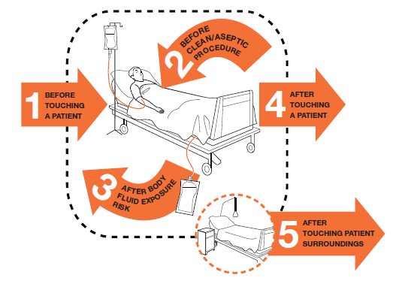
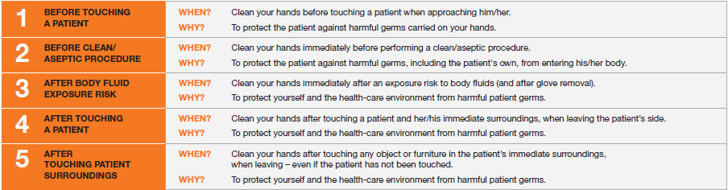
5 Moments of Hand Hygiene
Moments of Hand Hygiene
Notes:
Updated from Grant Hamilton 2020

Slide 77
5 Moments of Hand Hygiene
Moments of Hand Hygiene

Slide 78

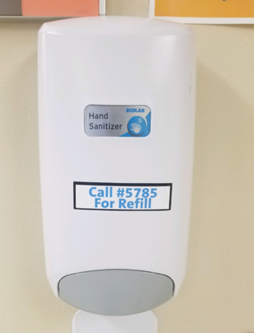
Hand Hygiene
Proper Hand Hygiene is the single most important factor for preventing Hospital Acquired Infections (HAI).
Hand hygiene procedures include the use of alcohol-based hand rubs (containing 60%–95% alcohol) and hand washing with soap and water.
Hands should be disinfected:
Scrub hands for at least 20 seconds
No artificial nails, tips, gels, etc.
Gloves should be used when touching blood, body fluids, etc.
Remove gloves and perform hand hygiene following any contact previously stated above
Notes:
Changed from 83 to 87%-2016 update

Slide 79
Covid-19 Pandemic
Wash your hands often
Wash your hands often with soap and water for at least 20 seconds especially after you have been in a public place, or after blowing your nose, coughing, or sneezing.
If soap and water are not readily available, use a hand sanitizer that contains at least 60% alcohol. Cover all surfaces of your hands and rub them together until they feel dry.
Avoid touching your eyes, nose, and mouth with unwashed hands.
Notes:
Added from CDC; 6/2020

Slide 80
Healthcare-Associated Infection (HAI)
Healthcare-Associated Infection (HAI) is an infection that develops after contact with the healthcare system. An HAI:
  Is not present or incubating at the time healthcare services begin
  Presents symptomatically 48 hours or more after admission or provision of care
Infections that develop before an individual enters a healthcare
facility are community-acquired infections. If a person develops an infection while receiving healthcare, it may be named a healthcare-associated infection (HAI).
Notes:
3/20/2019 Source: HealthStream Rapid Reg Clinical-Infection Control topic

Slide 81
HAI: Prevention
Preventing HAI is an important focus of the Centers for Disease Control and Prevention (CDC) and healthcare accrediting organizations.
  CAUTI (catheter-associated urinary tract infection)
  CLABSI (central line–associated bloodstream infection)
  CDI (Clostridium difficile infection)
  MRSA (methicillin-resistant Staphylococcus aureus)
  SSI (Surgical site infections)
  VAP (Ventilator Associated Pneumonia)
Protective measures to prevent the spread of infection
Follow infection control policies & procedures
Use standard and transmission-based precautions
Get vaccinated
Talk to patient & family about infection prevention
Use antibiotics the right way
Stay home when there are signs of infection
Notes:
2022-Source: HealthStream Clinical Infection Control

Slide 82
Bloodborne Pathogens
Bloodborne pathogens are infectious microorganisms in human blood that can cause disease in humans.
These pathogens include, but are not limited to,
  hepatitis B (HBV)
  hepatitis C (HCV) and
  human immunodeficiency virus (HIV)
Risk of Exposure
Workers in many occupations, including first aid team members, housekeeping personnel in some industries, nurses and other healthcare personnel may be at risk of exposure to bloodborne pathogens.

Slide 83
How are BBPs Transmitted?
Direct contact of infected blood to open cut, skin abrasion or mucous membrane (eyes, nose, mouth)
Needle sticks and other “sharps” injury
IV drug abuse
Blood transfusion
Sexual transmission
Perinatal
Breastfeeding (HIV)

Slide 84
Standard (Universal) Precautions
An infection control method to treat All human blood and certain human body fluids as if they were known to be infectious for HIV, HBV, and other bloodborne pathogens.
Apply to all patients regardless of their diagnosis or presumed infection status
Precautions apply to blood, body fluids, secretions, excretions regardless of whether or not they contain visible blood
Includes the use of hand washing and use of Personal Protective Equipment (gowns, mask, gloves, goggles) for protection against exposure to blood and/or body fluids
Use sharps (needles, scalpels, etc.) carefully and appropriately. For example, do not bend or recap needles; use safe injection practices; take care to prevent accidental sticks.
Notes:
Gloves- used whenever there is a reasonable expectation of exposure to blood or body fluids (BBF). Gloves MUST be used when caring for patients in Contact or Strict Isolation. Gloves must also be worn when providing care to a patient with an Artificial Airway (Vent or Trach)
Gowns- used whenever there is potential for contamination of clothing with BBF. Gowns MUST be used when caring for patients in Contact or Strict Isolation.
Masks
There are 2 types of masks used by Health Care Workers
The N-95 mask is used by HCWs to care for a patient in Airborne or Strict Isolation.
A surgical mask is used when there is anticipation of splash or splatter of body fluids when providing care and when caring for patients on Droplet precautions.
Goggles/ Eye Protection
Eye protection is used when there is anticipation of splash or splatter of body fluids
MUST be used when caring for a patient with SARS or rule out SARS.
MUST be used when caring for patients with Avian Influenza H5N1

Slide 85
Personal Protective Equipment
Gloves-use whenever there is a reasonable expectation of exposure to blood or body fluids (BBF)
    A MUST for: Contact Isolation.
    Artificial Airway (Vent or Trach)
Gowns-wear when there is potential for contamination of clothing with BBF.
Masks-there are 2 types of masks used by health care workers
    The N-95 mask is used by HCWs when caring for a patient in Airborne precautions.
    A surgical mask is used when there is anticipation of splash or splatter of body fluids when providing care and when caring for patients on Droplet precautions.
Goggles/ Eye Protection
    Eye protection is used when there is anticipation of splash or splatter of body fluids.
Notes:
Covered in system-wide education

Slide 86

Biohazardous Waste
Use “RED BAGS” for:
  Absorbent materials that are saturated with blood or body fluids.
  Non-absorbent, non-sharp devices contaminated with blood or bloody fluids (suction container liners, IV tubing, foley tubing, etc.).
  Blood products, body parts, tissues, etc.
  Must be labeled with the International Biohazard symbol.
Notes:
Sharp Containers
Sharps (needles, scalpel blades, etc.)
Disposable razors
Glass or plastic slides
Plastic disposable speculums (may break and become sharp)
Must be labeled with International Biohazard Symbol
Must NOT be more than ¾ full
Must be dated when closed for disposal

Slide 87
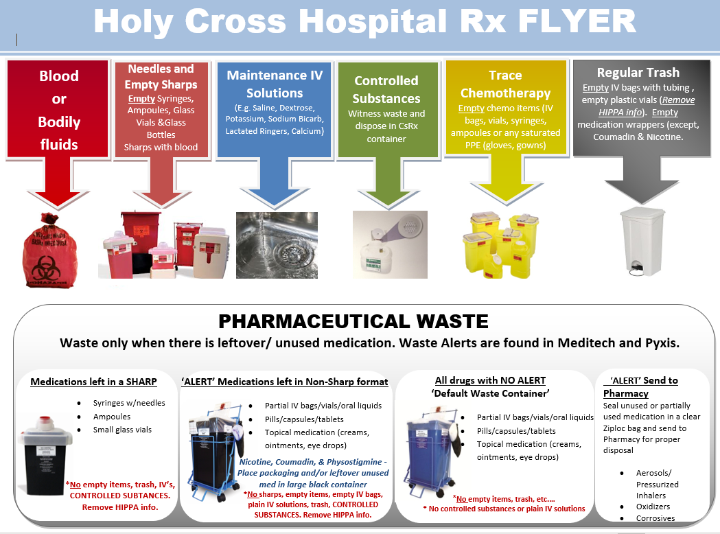
Waste Disposal
Notes:
6/2021-graphic from Alissa Fuller

Slide 88
Transmission-Based Precautions
Contact Precautions
  Precautions for patients known or suspected to be infected with microorganisms that are transmitted by direct or indirect contact with the patient, environmental surfaces or items in the patient’s environment
  Wear gloves and gown must be worn the entire time you are in the patient’s room
  Resistant bacteria (MRSA, VRE, C. difficile, other MDROs-Multidrug resistant organisms)
  Scabies & Lice
Notes:
Patients with C diff are not coherted.

Slide 89
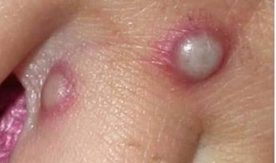
Monkeypox
This is a rare, sometimes life-threatening zoonotic infection. An endemic in west and central Africa.
This is caused by Monkeypox virus (which is an orthopoxvirus). Specific animal reservoir unknown, buy likely small mammals.
It can spread from infected animals to humans and person-to-person via respiratory secretions, intimate skin-to-skin contact, contact with infected body fluids (e.g., fluid from vesicles and pustules), fomites (e.g., shared towels, contaminated bedding)
Isolation Precautions – Airborne and Contact
Notes:
7/6/2022 Monkeypox added per IC; 1/25/2023 updated Isolation to Airborne instead of Droplet
10/30/23 Remove slide for 2024

Slide 90
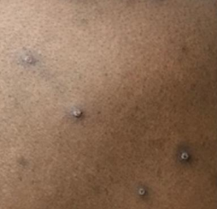
Monkeypox
Clinical Symptoms
Skin rash or enanthem in all patients
Lesions in different phases of development seen side-by-side
Rash either scattered or diffuse; sometimes limited to one body site and mucosal area (e.g., anogenital region or lips/face)
Presenting complaint sometimes anorectal pain or tenesmus; physical examination yields visible lesions and proctitis
Prodromal symptoms mild or not occurring
Fever, lymphadenopathy not occurring in all patients
Some co-infections with sexual transmitted infections (STIs)
Notes:
10/30/23 Remove

Slide 91
Transmission-Based Precautions
Droplet Precautions
  Microorganisms transported by large particle droplets, generated by an infected patient during coughing, sneezing, talking or performance of other procedures
  Wear a surgical mask the entire time you are in the patient’s room
Bacterial meningitis and meningococcemia
Pertussis
Influenza
Mumps, Rubella, Parvovirus B 19

Slide 92

Transmission-Based Precautions
Airborne Isolation Precautions
  Used for patients known or suspected to be infected with pathogens that are transmitted by airborne droplet nuclei (ex. TB, Measles, Covid-19)
  Wear respiratory protection (N-95 particulate respirator mask) when in patient’s room; keep door closed; patient must be in a negative pressure room.
Notes:
All patients admitted with or suspected of having an airborne contagious disease will be placed in a negative pressure isolation room or a private room with a portable HEPA filtration device, depending on the admission diagnosis.

Slide 93

Flu Season
Adults shed the infectious influenza virus at least 1 day before any symptoms appear and continue to shed for 5-10 days after symptoms appear
Approximately 50% of influenza infections can be asymptomatic
Both symptomatic and asymptomatic individuals can shed the virus and be a source of infections to others, especially patients
It is the policy of Trinity Health that all Employees and Health Care Providers / Personnel (“HCP”) are required to receive an influenza vaccination, and any subsequent booster vaccinations, unless Trinity Health approves an exemption for either medical contraindications or as a religious accommodation. Employees with an approved exemption may be required to take other precautions as defined by Trinity Health, including but not limited to wearing a mask and physically distancing to prevent the spread of influenza. (See Influenza Vaccine Policy)
Read HCH Influenza Vaccine Policy
Notes:
TJC readiness PPT

Slide 94

Tuberculosis
TB is a disease caused by a bacterium called Mycobacterium tuberculosis. The bacteria usually attack the lungs, but TB bacteria can attack any part of the body such as the kidney, spine, and brain. If not treated properly, TB disease can be fatal.
Symptoms of TB disease include:
a bad cough that lasts 3 weeks or longer
pain in the chest
coughing up blood or sputum
weakness or fatigue
weight loss
no appetite
chills
fever
sweating at night
Source: www.cdc.gom/tb

Slide 95
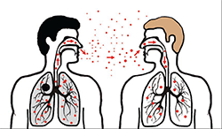
Transmission & Prevention of TB
Transmission
Prevention
TB is spread through the air from one person to another. The TB bacteria are put into the air when a person with TB disease of the lungs or throat coughs, sneezes, speaks, or sings. People nearby may breathe in these bacteria and become infected.
Close contacts at highest risk of becoming infected
Early recognition-signs and symptoms, history, etc., especially in ER
Institution of airborne precautions (negative pressure room with special air handling) to prevent transmission by droplet nucleii; N-95 Particulate Respirators for health care workers
Isolation of HIV + patients with respiratory symptoms until TB is ruled out
If exposure occurs, screening process is initiated

Slide 96
Multidrug Resistant Organisms
Transmission Prevention Strategies
MDRO is a bacterial pathogen that is able to survive exposure to multiple commonly used antibiotics due to changes in genetic coding.
As a result, more powerful, more toxic and more expensive antibiotics must be used to treat infection and eradicate these organisms.
MDRO infections are associated with increased lengths of stay, costs, and mortality.
HAND HYGIENE
Use Contact Precautions (gowns, gloves and good hand hygiene) for care of these patients even if contact is not anticipated
Private room when possible-appropriate patient placement
Alert system for patient re-admission
Monitor cleaning performance & use effective disinfectants and agents
Dedicated patient equipment
Touching surfaces in the patient’s room is the same as touching the skin of the infected patient

Slide 97
Antibiotic Resistance
Antibiotic resistance is the ability of bacteria to resist the effects of an antibiotic – that is, the bacteria are not killed, and their growth is not stopped.
Resistant bacteria survive exposure to the antibiotic and continue to multiply in the body, potentially causing more harm and spreading to other animals or people.
Antibiotic-resistant strains contribute significantly to HAI.
We can slow the spread of bacterial resistance by using antibiotics wisely.
Holy Cross Health is committed to antimicrobial stewardship. It is through our efforts in stewardship we will be able to provide our patients……
  The right antimicrobial
  The right dose
  For the right indication and duration
  While minimizing unwanted consequences
cdc.gov/drugresistance/index.html
Notes:
2020-last bullet added;

Slide 98
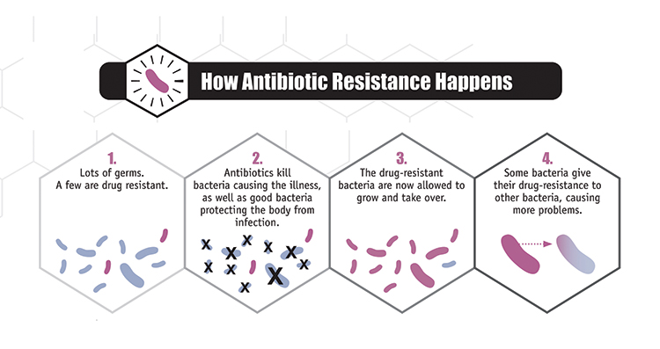
How Antibiotic Resistance Happens

Slide 99
Clostridium Difficile
C.Diff is a bacterium that causes diarrhea; it is shed in the feces; most cases of infection occur in patients taking antibiotics.
Caused by exposure to antibiotics and other medications
How it is spread
Spread through contact with contaminated surfaces or items; C diff spores can be found on things in the environment like bed linens, bed rails, bathroom fixtures and medical equipment
Preventing Transmission
Place patient in a private room on Contact Precautions (use yellow sign)
Wear gowns and gloves for patient contact.
Perform hand hygiene with antimicrobial soap and water
Use dedicated equipment for the patient (disinfect shared equipment after use)
Most common symptoms:
Watery diarrhea, fever, loss of appetite, nausea, abdominal pain & tenderness
www.cdc.gov/faq
Notes:
Updated from cdc faq

Slide 100
Holy Cross Recognitions

Slide 101

The Joint Commission
Advanced Certification in Heart Failure
Congestive Heart Failure program
  provides the next generation of heart failure care
  has met and seeks to maintain The Joint Commission's high standards in providing stroke or heart failure care.
Notes:
4/2019-from HCH website

Slide 102
What is Heart Failure?
Heart Failure (HF) is a very common problem in the United States. It affects over 550,000 Americans each year. It is the leading cause for adults over the age of 65 to be admitted to the hospital.
Heart failure is called congestive heart failure when fluid builds up in various parts of the body. Heart failure symptoms usually develop over time as the heart becomes weaker and less able to pump the blood that the body needs. When you have heart failure, it doesn’t mean that the heart has stopped beating. It means that the heart is not pumping blood as it should. The heart keeps working, but the body’s need for blood and oxygen is not being met.

Slide 103


The Joint Commission Certification for Thrombectomy-Capable Stroke Centers
Holy Cross Health is certified as Thrombectomy-Capable Stroke Center
Holy Cross Provides round-the-clock personnel, infrastructure, expertise and programs to diagnose and treat stroke and TIA (Transient Ischemic Attack) patients, who require a high degree of medical and surgical care, specialized tests or interventional treatments.
Notes:
From HCH website 4/2019

Slide 104
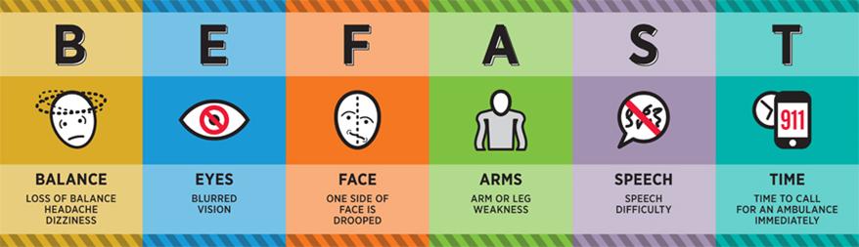
Stroke Warning Signs
What is a Stroke?
Stroke is a disease that affects the arteries leading to and within the brain. It is the No. 5 cause of death and a leading cause of disability in the United States.
A stroke occurs when a blood vessel that carries oxygen and nutrients to the brain is either blocked by a clot or bursts (or ruptures). When that happens, part of the brain cannot get the blood (and oxygen) it needs, so it and brain cells die.
Notes:
2022-updated image from Lori
American Stroke Association: www.strokeassociation.org

Slide 105
END
Click Exit to close the program.

